Slide 1
Solar panel damage classification

Slide 2
Project Leadership
Project sponsor
Bharani kumar Depuru
Director and Co_Founder at Innodatatics
linkedin.com/in/bharanikumardepuru
PROJECT MENTOR
Dev Mohanty
Akshaya Acharya

Slide 3
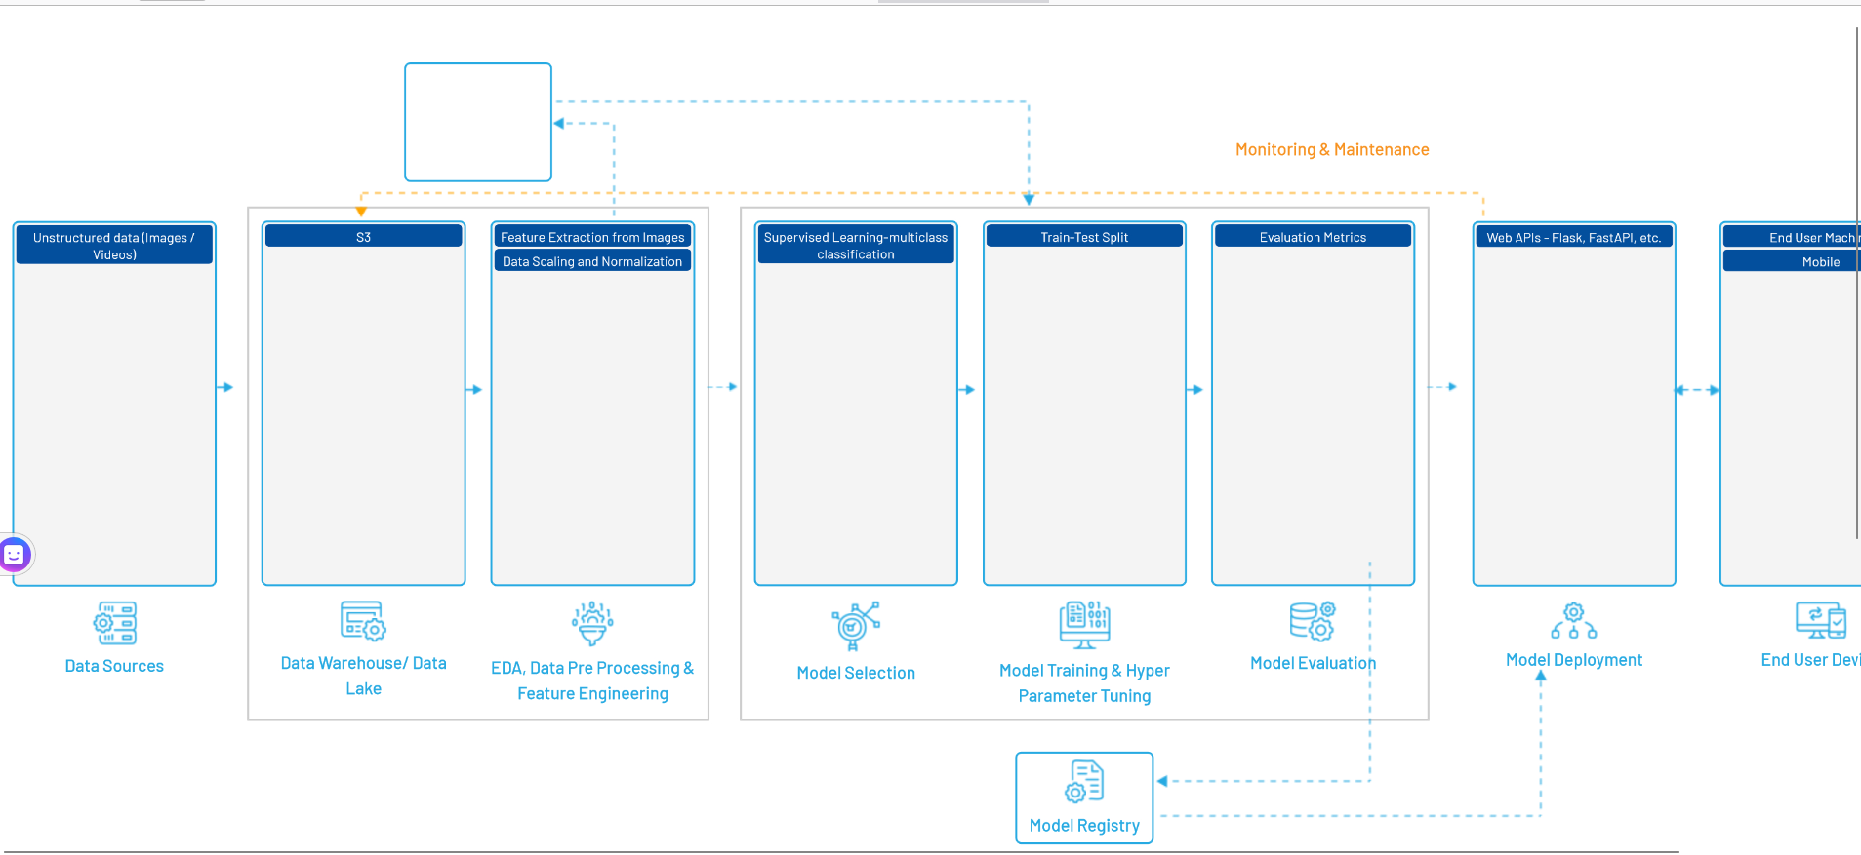

Slide 4
Contents
Business objective
Business Constraints
Project Architecture
Data collection and details
Exploratory Data Analysis
Visualization
Modeling
Evaluation
Deployment

Slide 5
CRISP-ML(Q) Methodology
There are six stages of CRISP-ML(Q) Methodology
1.Business and data understanding
2.Data preparation
3.model building
4.Model evaluation
5.Model deployment
6.Monitoring and maintenance

Slide 6
Business Problem :
Our client , a prominent solar energy company, needs to enhance the monitoring and maintainance of their large PV system portfolio.Despite their dedication to clean energy, their current fault detection methods are inefficient.They seek more effective approaches to ensure optimal performance and reliability while minimizing resource usage.
Business Objective : Maximize solar PV system uptime
Business Constraint : Minimize maintainance costs

Slide 7
Success criteria :
Business Success Criteria : Reduction in system downtime by 15%
Machine Learning Success Criteria : Achieving an accuracy rate of at least 95% in identfying faulty solar modules
Economic Success Criteria : Achieving a 10% reduction in maintenance costs associated with solar modole faults

Slide 8
Technical stacks
Python
Google Colab
Roboflow
Spyder
Streamlit

Slide 9
Data collection and understanding
Business understanding
First understand the business problem
. And collected 10 research papers and gathered information from that research papers.
.Building a project Architecture based on that information
Data collection :
. Data is collected from u tube
. All solar panel videos are collected
. Frames were captured at 25fps
. Stored all datasets in drive

Slide 10
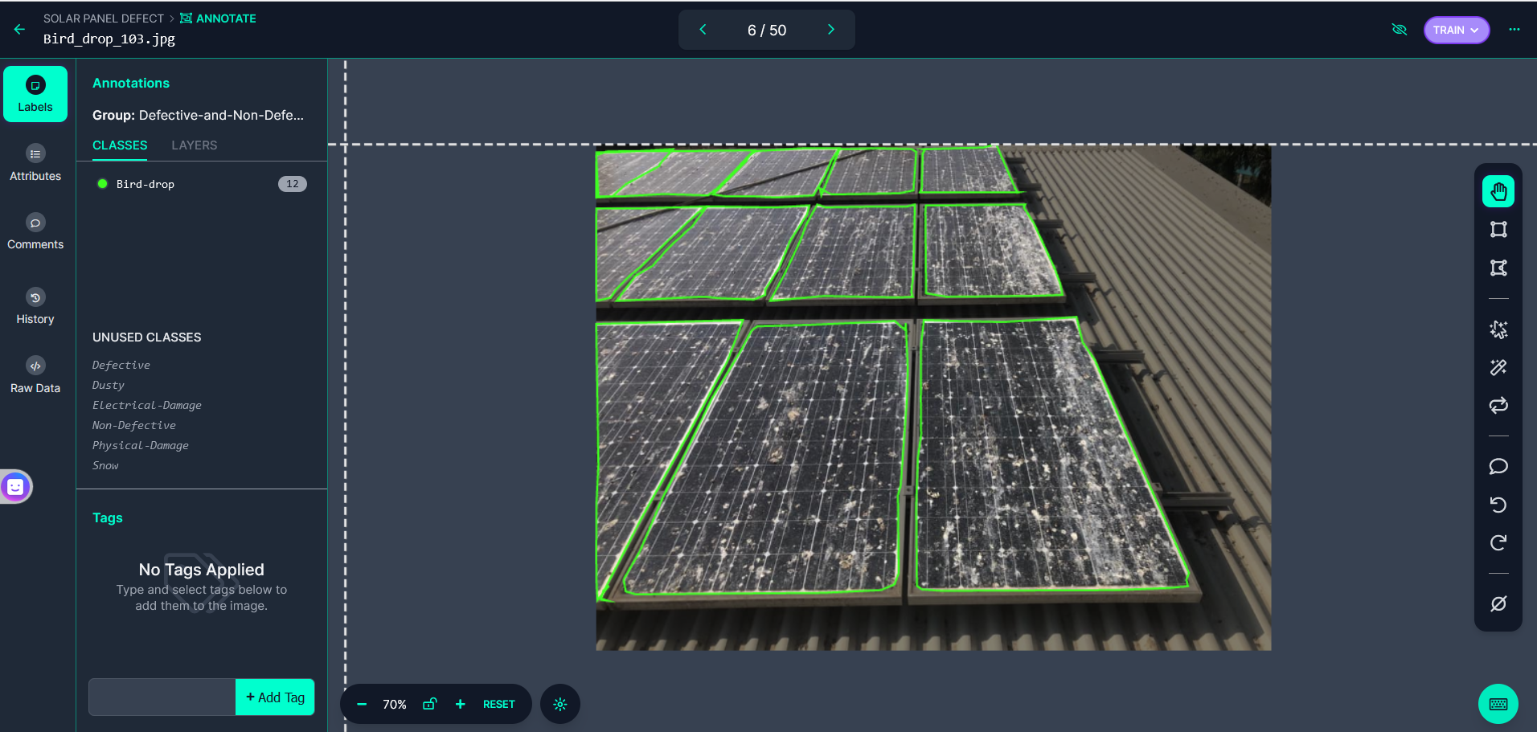
Tools used – ROBOFLOW Used Roboflow and the images collected were uploaded into Roboflow and started annotating images Classes were created Defective ,Bird drop, Dusty, Electrical Damage, Physical Damage,Snow, Non Defective

Slide 11
System requirements
GPU for faster training of deep learning models.
Python with necessary libraries installed.
Sufficient storage place for storing datasets

Slide 12
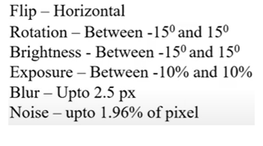
Data preprocessing and Augmentation : 1.Once the data is collected we annotated the data in roboflow and given classes as Defective,Bird drop, Dusty, Electrical Damage, Physical Damage, Snow, Non Defecctive 2.Applied auto orientation to images 3.Resized images to 640 x 640 pixels
AUGMENTATION :

Slide 13
Generating Dataset and model selection
Export Dataset : In roboflow exported the generated dataset in YOLOv8 format for further processing and training
Model selection : Multiclass object detection model __ YOLOv8

Slide 14
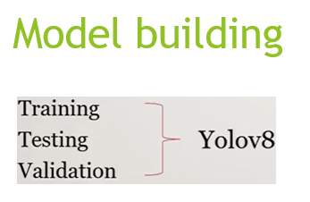

Slide 15
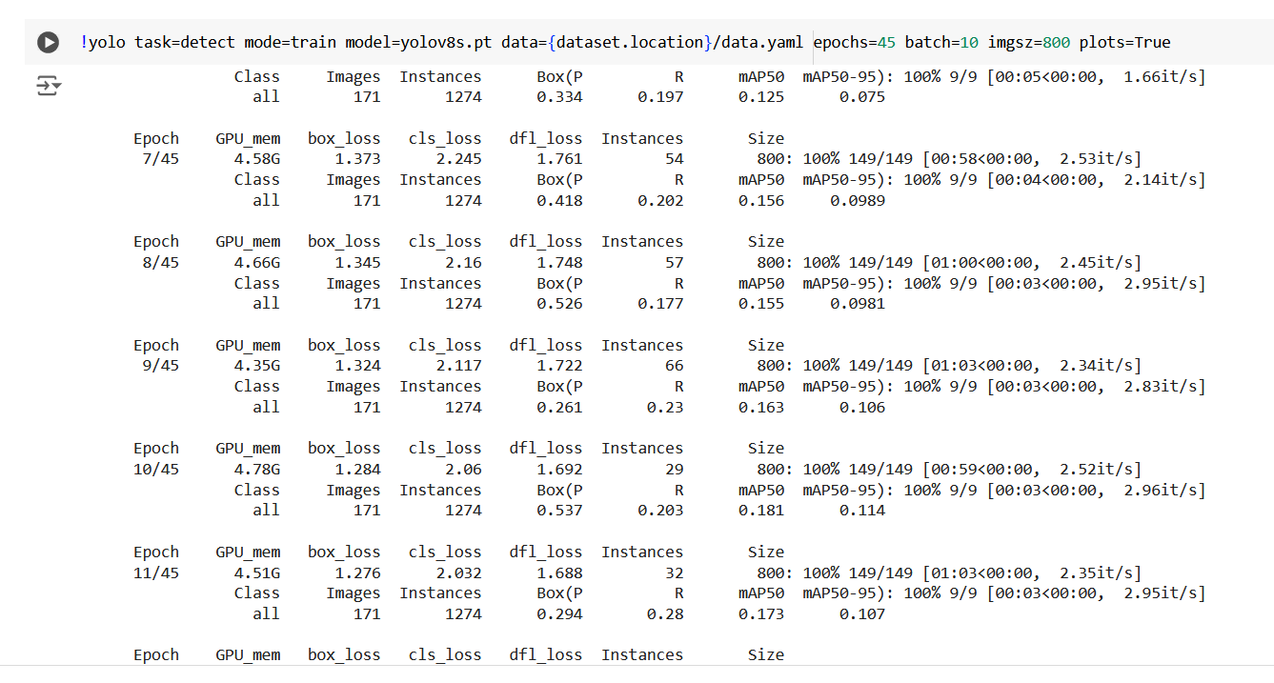
Model training

Slide 16
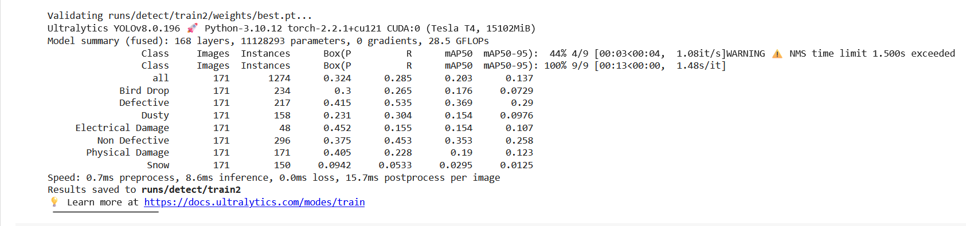
Model Accuracy comparision

Slide 17
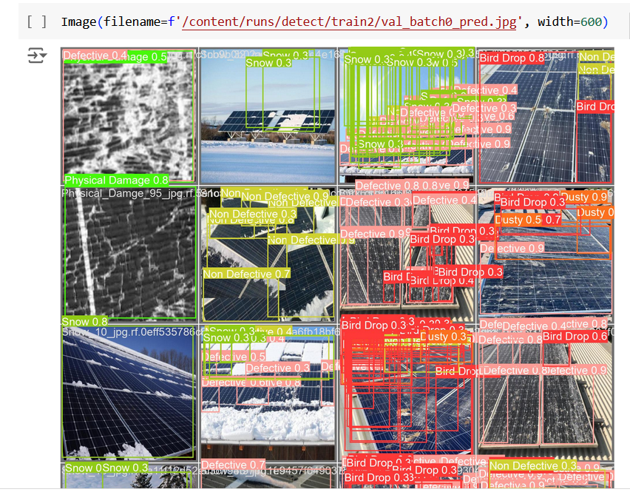
Screen shot of output

Slide 18
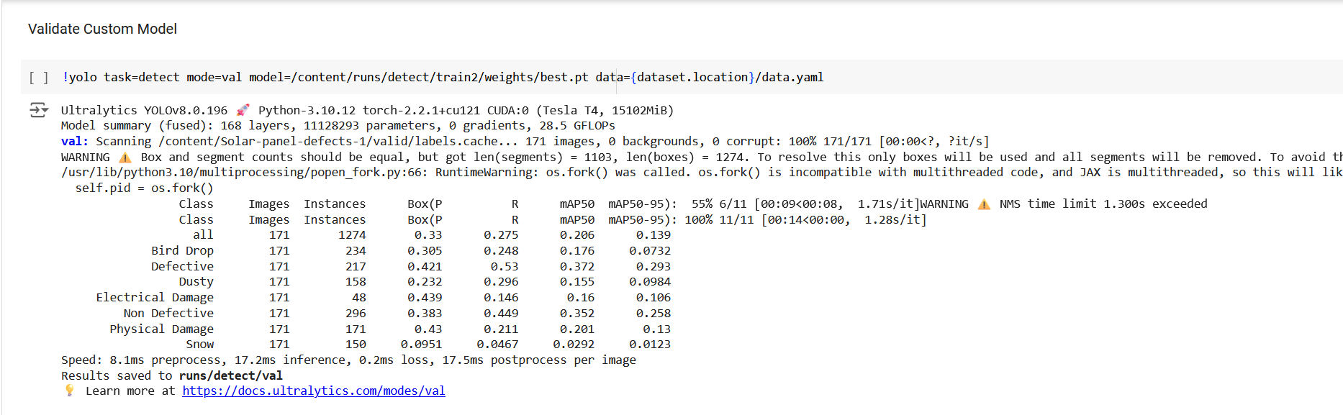

Slide 19
Model Deployment - Strategy
Streamlit is used for deploying the trained YOLOv8 model as a web application

Slide 20
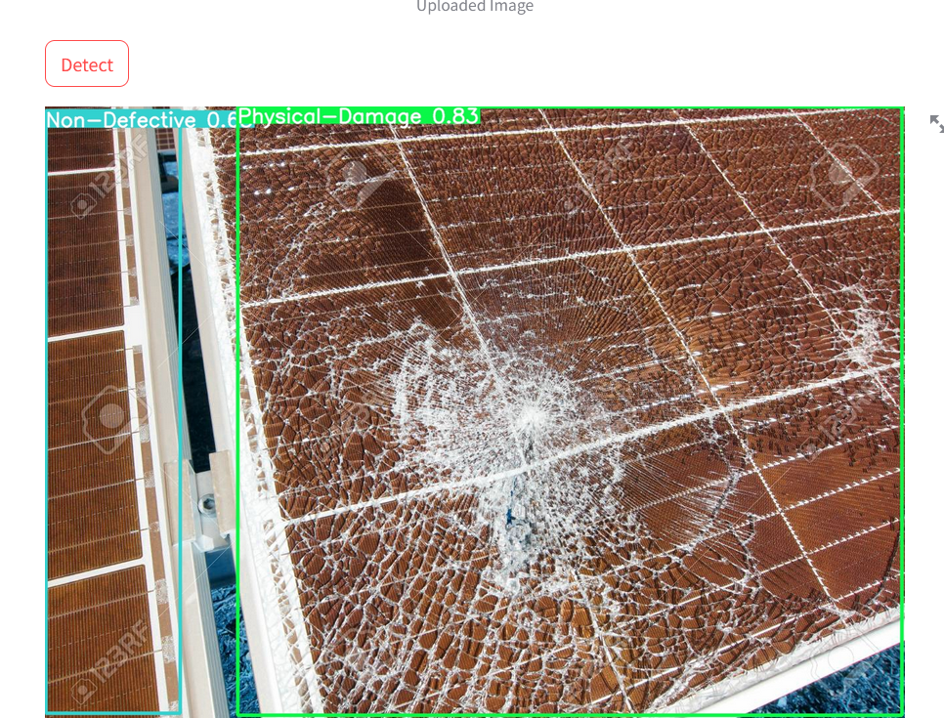
Screenshot of Deployment - output

Slide 21
Challenges
In Roboflow ,annotating images consumes more time to annotate.

Slide 22


